Slide 1
Global Populations.
By James Simpson.

Slide 2
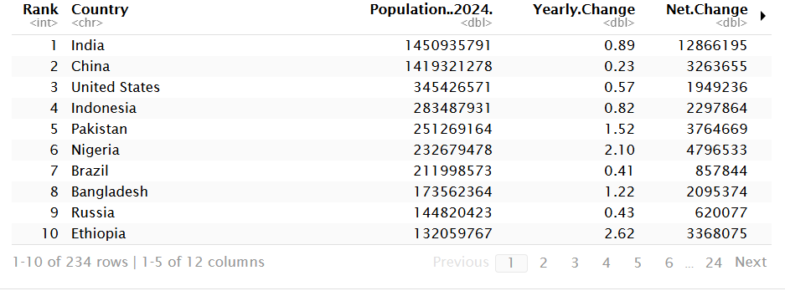
Data.
My data was World Population by Countries (2025), a primarily numerical dataset. It has 234 rows and 12 columns meaning 2808 total values.
Most of the data had to be cleaned with Population Net change migrants and other variables needing commas (,) to be removed with Yearly change and Urban population needing percentage (%) to be removed.

Slide 3
Statisitcs.
For such a large dataset there was a suprisingly small amount of outliers.
Despite that there were a few, for yearly change percent Germany had an 0.0% change with despite its size of 84 million only a increase of 4000 people, inversely because of its smaller size Saint Martin's increase of 1200 people gave it a 5.04% change from 2024. The smallest country Holy See also had a 0% change because there was no change in population from last year.

Slide 4
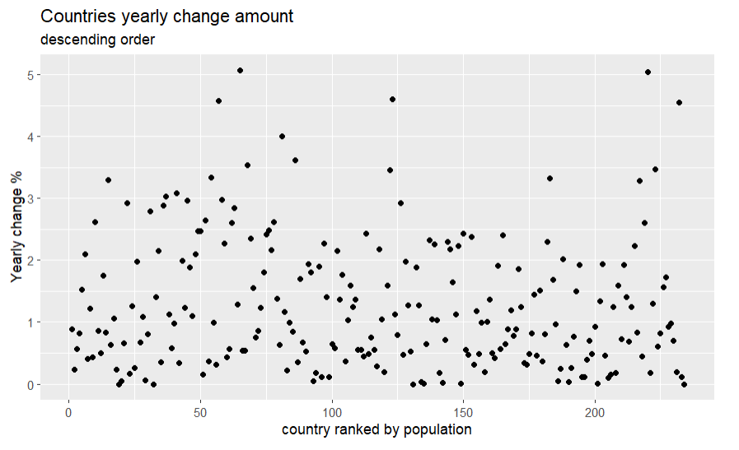
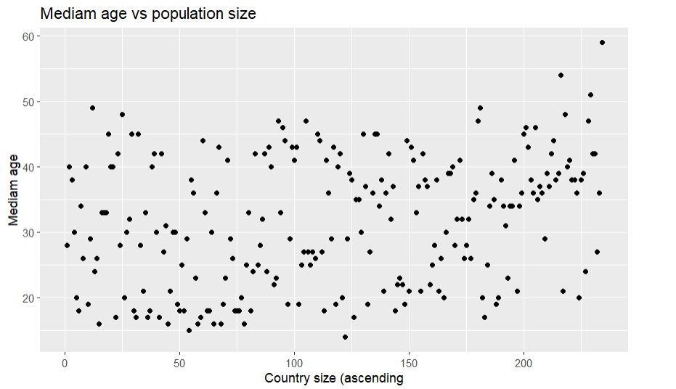
Visuals.
There is a slight pattern ascending pattern for yearly change but determing that from the graph isn't easy to tell.
There is a much more visible trend of higher mediams at lower populations here instead.
Yearly change vs population ascending (Left) andd Mediam Age vs country by population ascending.

Slide 5
Trends.
Despite the large dataset (or maybe as a result of it) there wasn't many trends in it. Many were unable to be determined any clear pattern.
There were some patterns however most surprisingly Mediam age actually decreased with smaller countries on average having an higher mediam age.
inversly data like migrants, world share and land area increased proportionally to population with more populated countries tending to have these in surplus.

Slide 6
Retrospect.
There was some correlation found in the data however one of the problems with the data's limited scope makes any results unclear. From the time period 2024-2025 Is to small to determine any consistent results and account for any outliers.
Pattern wise, was mediam decreasing with larger populations or any other similar trends an outlier because of the small scope of 2024-2025 or a long-term pattern?
This whole project was a lesson in scope, rather than deciding to do all the population's a dumb decision in retrospect, it would've been much more effective (and easier on my part) to simply pick a smaller sample of countries and do any wanted data of them over the years.

Slide 7
Sources.
World Population by Countries (2025) on Kaggle.com.

